Slide 1




Wireless Sensor Network (WSN)
for Home Automation
Presentation by: Carl Sagrado
Notes:
Introduce yourself –> talk about the basic concept of the project - > Presentation topics For those who doesn’t know me… my name is Carl Sagrado and for those who know me – “howareyall?!” Image Reference : This Photo by Unknown Author is licensed under CC BY-SA This Photo by Unknown Author is licensed under CC BY-SA

Slide 2
PRESENTATION TOPICS
04
01
02
03
06
PROJECT OVERVIEW
Web Interface
- General Project Scope
-frontend design and implementation
Developments
05
Wireless Sensor Network
Sensor Node
Base Station
Remote Device
- Current Progress, challenges and future developments
Project Demo & Summary
Web Server
- Backend design and implementation
- Presentation summary
Notes:
This presentation will covers 6 sections, namely Project Overview, Wireless Sensor Network, Web Server, Web Interface, and finally summary.

Slide 3

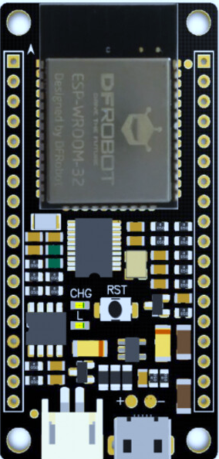







01
PROJECT OVERVIEW
Wireless Sensor network with web interface
Web Interface
Web Server
Sensor Network
HTTP Request/Response
Serial Communication
Collects and manage information between the web interface and sensor network
Autonomously collects environmental data and presents collected data to the web server
Interacts with the user
Notes:
This project encompass’ of 3 sections that was developed:
Web Client – which interacts with the user (using a browser - which will be served by the server and returns a page)
Web server – which collect and manage information between the web interface and sensor network
And finally, sensor network – which autonomously collects environmental data and presents collected data to the web server
The sections are divided into 3 parts and developed individually which will be interlinked together as a whole product at the end. SO we are first going to discuss about the WSN

Slide 4
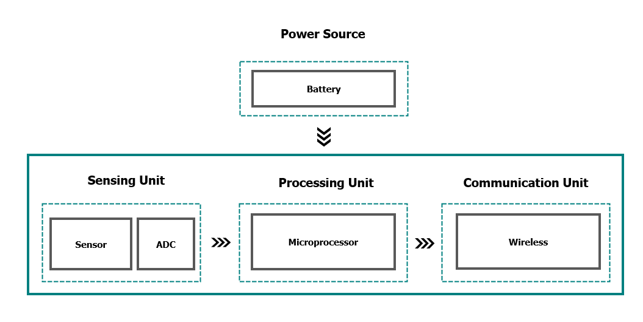
Wireless Sensor Network (WSN)
02
Wireless Sensor Network (WSN)
Wireless Sensor Networks (WSN) is commonly defined as a collection of small powered wireless nodes equipped with sensors.
Sensor Node
These sensor nodes are grouped together in a wireless network and are used to actively monitor environmental conditions such as temperature, humidity, CO2, etc.
Typical communication structure of the nodes involve forwarding of data through other nodes to a gateway or a base station, which forwards data to a computer device on the network.
Remote Device
Remote Device
Base Station
Sensor Node
Typical Structure of a network node: - Processing Unit
Communication Unit
Sensors
Power Source
Different nodes
Base Station, Sensor Node, Remote Node
Notes:
WSN commonly defined as a collection of small powered wireless nodes equipped with wireless capabilities sensors that perform collaborative measurement process.
Typical structure node is comprised with the following – - Processing unit
Communication Unit
Sensors
Power source
To develop a wireless sensor network, the mentioned structure components of the network nodes require consideration.

Slide 5
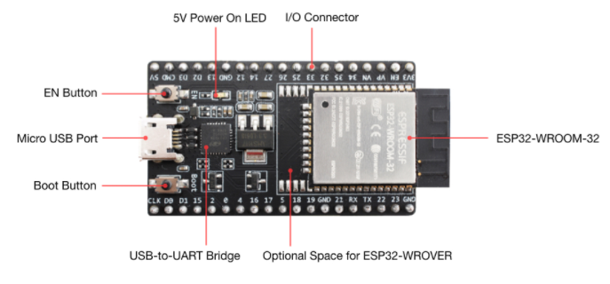
02
Wireless Sensor Network (WSN)
ESP32, Sensor Modules and Relay Module
ESP32 Development Board
For prototyping this project, we used a development board called ‘ESP-32’. This board comes in packed with all the necessary features and capabilities required for our sensor nodes and other nodes in the network. ESP-32 - features - Low powered system on a chip microcontroller (3.3V) - Single 2.4GHz Wi-Fi and Bluetooth combo - Open source ESP-Now Library - Wi-Fi modes (Station mode, Access point mode, Access point and station mode) - 36 GPIO pins
Processing Unit & Communication Module in one
ESP-Now library, Wi-Fi mode access point, Wi-Fi
Notes:
The next few slides we are going to talk about the hardware devices we used in developing nodes of the network.
There are three are 3 specific hardware’s that we are going to briefly discuss, namely the ESP32, Sensor Module and the Relay module
For prototyping this project, ESP-32 general-purpose development board will be used which packs with all the necessary features required for the sensor nodes to operate including, computing power, wireless capabilities, I/O connections, and in-built low power management incorporated into one single development board.

Slide 6
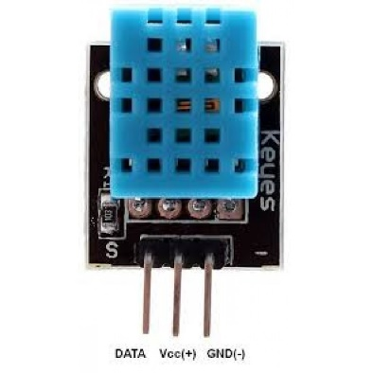
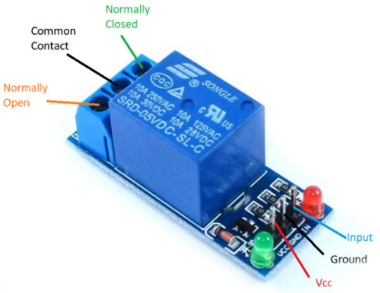
02
Wireless Sensor Network (WSN)
ESP32, Sensor Modules and Relay Module
Sensor
- Temperature and Humidity Sensor Module
- Consistent, reliable and stable
- Low powered (3.3V)
DHT11 Module
- Relay switch is an electrically operated switch controlled by low-power signal. The small signal turns the switch on or off and are commonly used for controlling high powered applications. - The incorporation of relay modules to the project enables the control of the end device, remotely.
Relay Module
Notes:
The next hardware we are going to talk about is the DHT Module: DHT module - This module features a dual-sensing capability to a digital signal output, it can read temperature and humidity conditions which converts it to an electrical signal that our board reads. This module comes with a DHT library which allows interpretation of electrical signal to output values that represents the temperature and humidity reading. The sensor module operates at 3.3V, and found to be consistent, stable and reliable. For remote switching capabilities, a 5V one channel relay module is used for the prototype. Relay modules has Relay switch. A relay switch is an electrically operated switch controlled by low-power signal. The small signal turns the switch on or off and are commonly used for controlling high powered applications. - The incorporation of relay modules to the project enables the control of the end device, remotely.

Slide 7
02
Wireless Sensor Network (WSN)
Wireless Connectivity Using ESP-NOW Protocol
Sensor Network
- Peer to Peer communication using MAC address of each node to communicate to other nodes
Sensor Node 1
Remote Device 1
- Simple to implement
- No handshake
Base Station
Base Station – Information hub
Sensor Node 2
Sensor Node – Collects environmental data and sends to base station
Remote Node – Switches remote device
Sensor Node 3 w/ Remote Device
*All data collected by the base station is sent to the server via serial communication.
*Control instructions of remote devices is sent by the base station and/or sensor node
Notes:
Wireless Connectivity using ESP-NOW
For implementing wireless connectivity for each node in the sensor network, we use the ESP-NOW communication protocol which utilizes the hardware address for each node, also known as MAC address. The MAC address information represents as the network address of each node to enable a peer to peer communication between each node in the network.
The nodes are designed for each node to be placed at different parts of the house i.e. room, kitchen, living room etc.
There are 3 types of node in the network. Base station, Sensor Node and Remote node.
The network recognition for each node in the network is hardcoded into each node. Meaning each set of nodes are permanently set to communicate to a particular device in the network i.e. Node 1 communicates to remote device 1 and the base station. Similarly, the Remote Device 1 only communicates to sensor node 1.
The network is masked and constructed with multiple nodes separated at different distances at different locations, the network uses a peer-to-peer communication method where each node is considered a peer and to communicate, a pairing mechanism are to be initialized.

Slide 8



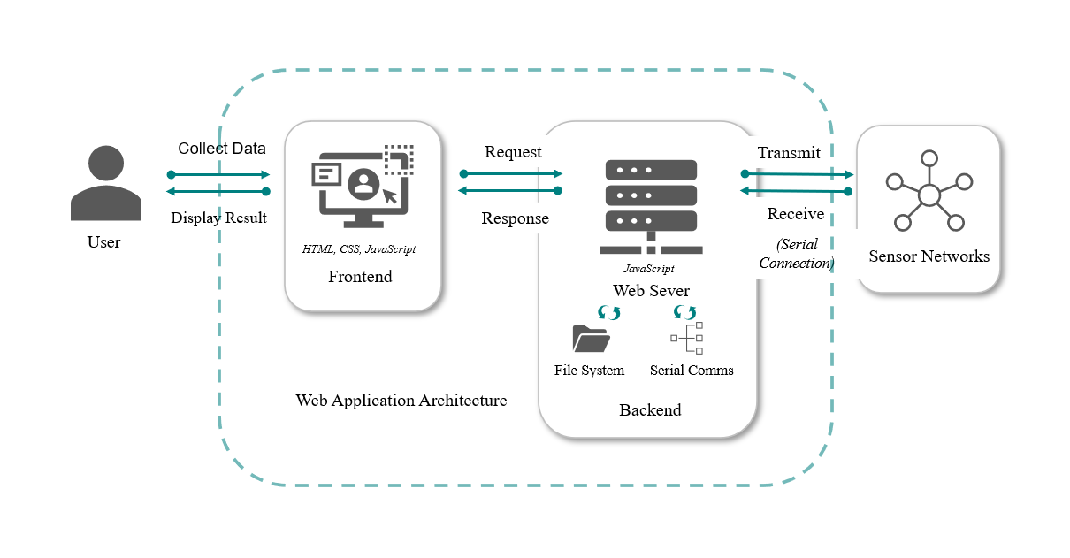
03
Web Server
Node JS Platform
Backend Services
- Open-source cross-platform runtime environment for delivering backend services for serving the web application and sensor data.
- JavaScript is used as a programming language for the server-side development.
- Server is responsible for handling HTTP requests and presents data to web interface
SerialPort Module
(Server- Base station communication)
- NodeJS framework module that enables serial communication between base station and web server.
Socket.io
(Interface – Server communication)
- Web socket library that enables real-time and bidirectional communication between client and server.
- Provides full-duplex communication channels over a single TCP connection, highly suitable for our application.
Notes:
A web server is a software application that typically handles web requests by web clients and returns web pages in response to requests. For the prototype development, a web server serves for two particular purposes, data handling from the sensors network and handling web client requests. There are different technologies required to enable a fully functional server, which usually falls into two categories, namely:
Backend – handles the processing of data processing, exchange and storing.
Frontend – handles the presentation of data, navigation, and styling.
The webserver will be used for two purposes, data handling from the sensors network and handling web client requests…
To enable server to base station communication – we use the nodejs framework module to allow the server to listen to a designated communication port which links to the base station via serial communication
Socket.io provides full-duplex communication channels over a single TCP connection, highly suitable for our application.

Slide 9
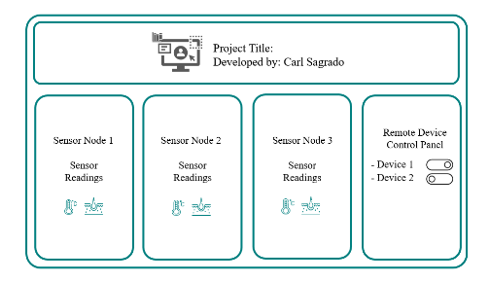


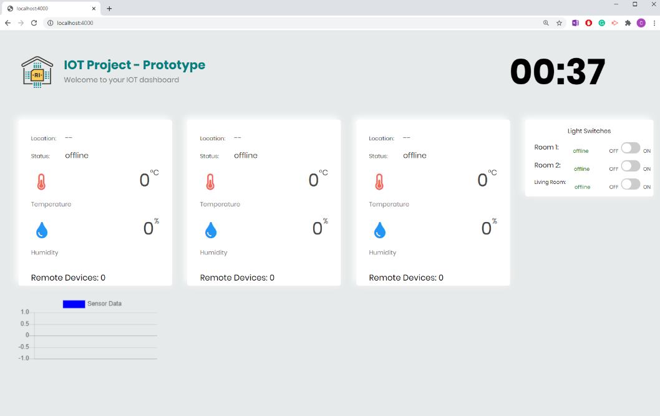
04
Web Interface
Frontend
Concept Design
Local Time
Web Interface
localhost:4000
HyperText MarkupLanguage (HTML) – for the web page structure
Cascading Style Sheets (CSS)
– for web page styling
JavaScript(JS)
– for the background functions
Sensor Nodes output display
Remote Devices
Notes:
When a request from a client to the webserver is generated, it is expected to return a navigable web page that allows the user to interact with the wireless sensor networks. The page displays all the information, i.e. sensor readings such as temperature, humidity, CO2 as well as the remote device statuses. As designed, the streams of data are displayed as soon as it becomes available and received by the webserver without the need of refreshing the page. We started off with a concept design on how we are going develop an interface for the project, after listing through the requirements of the project, we proceeded to design and the result of the webpage is in the screen. The web interface was given a basic structure using HTML where each element is provided with identifiable attributes which is used for styling with CSS. The underlying functions of the page were written in JavaScript, and its embedded ability to asynchronously connect to the web server is through a web socket connection.

Slide 10
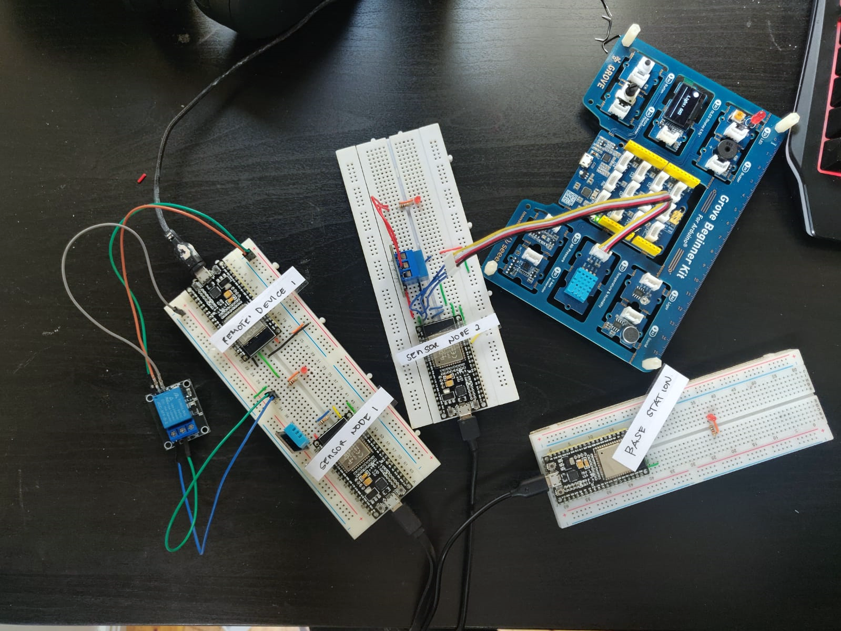
JAN ‘20
END
04
HERE WE ARE
Progress
LED 2
Relay Switch Module 2
Remote Device Controller
Temperature & Humidity Sensor 2
LED 1
Relay Switch Module 1
Sensor Node 2
FEB ‘20
MAR ‘20
APR ‘20
Temperature & Humidity Sensor 1
Sensor Node 1
Base Station
Notes:
So here we are, as you can see the two sources is isolated.
The PWM signal will be fed at the input – detected at the other side, which will be fed to the input of the MOSFET driver and down to the MOSFET.
Varrying of the signal depending on the signal symmetry (ON: percentage) causes the mosfet to turn on and off at a very fast speed allowing us to control the motor.

Slide 11
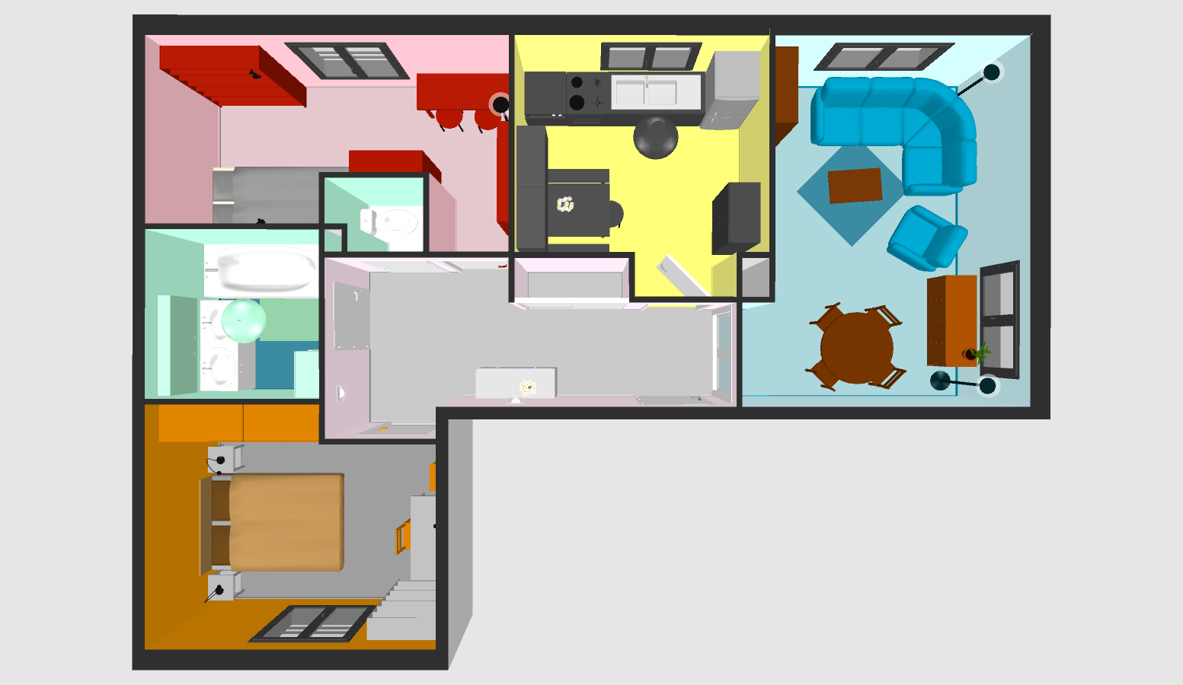
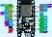


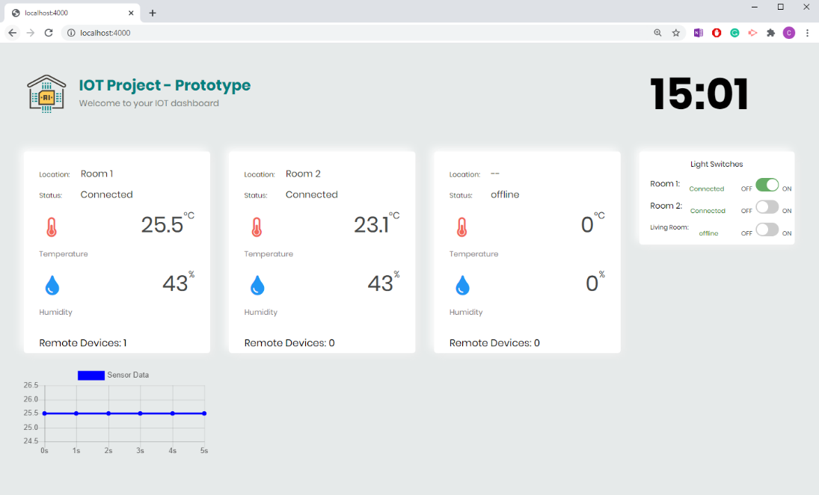
JAN ‘20
END
04
HERE WE ARE
Progress
Sensor Node 1
Remote Device 1
Base Station
Sensor Node 2 with Remote Device
Web Interface
Graphical placement location of each node
FEB ‘20
MAR ‘20
APR ‘20

Slide 12
Project Demo

Slide 13
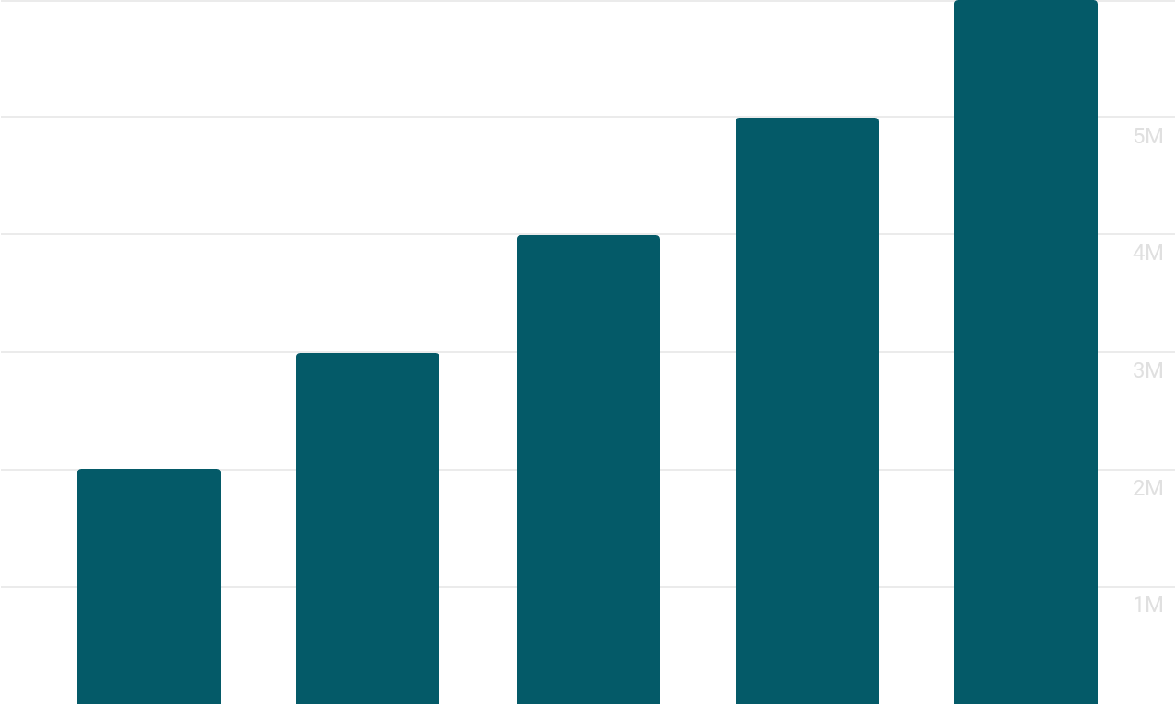
05
1) Current Progress
CURRENT PROGRESS, CHALLENGES & FUTURE ACTIONS
The working concept of the WSN network was built & proven to be working according to desired output.
Sensor devices is operational at 3.3V and relay switch is partially operational at same voltage.
Environmental data are read and displayed in real time with a maximum of one second delay between detection and publishing.
Remote devices are responsive to the control command generated by the web interface
Components availability
Main voltage supply from ESP board is 3.3V while relay switch recommended voltage supply is 5V.
JAN ‘20
END
FEB ‘20
MAR ‘20
APR ‘20
Future Actions (3
Investigate alternative wireless technologies that can be used to incorporate to the current setup to improve communication.
Enable the network node to have self-organising capabilities for the event of node failure or additional node on the network
Addition of CO2 sensors to provide more environmental information.
Address issues relating relay switch power supply and investigate alternative solution.
Where possible, add additional features to the current setup such as voice control, smartphone access and web interface responsiveness.
2) Challenges
Notes:
So our current progress,
Following testing, we now have a working concept of a motor controller. It was built tested and proven to output desired result
Circuit can operate up to 32V and (safeside) 1.6A current (We will talk more on that in the next section)
PWM signal works and we are able to retrieve the pulse signal from the other side of the isolated area.
It wasn’t all easy and straightforward – along the way we did encounter few issues which required modification of the previous model. The main issues so far are mainly, POWER stage section – our MOSFET heats up too quickly (understandably due to current present between drain to source. Resistance value used between MOSFET driver and MOSFET requires further investigation to optimise power efficiency.
Thus for future actions we are going to address the above and also add a few more parts to attain effect motor controller system . We are going to ----------

Slide 14
6) SUMMARY
Project scope
Wireless Sensor Network
Web Server (Backend)
Web interface (Frontend)
Current Progress & Next developments
Notes:
In summary, we’ve discussed the scope and requirements involve for this project- we talked about PWM and how it relates to motor control –
We went through the operation of the DC Motor and the relative components used for the motor controller.
We discussed about the power stage and why we use MOSFET and MOSFET driver for this project.
Circuit isolation was briefly discussed and the importance of it and finally, what we aimed to do for future development of the Motor Controller

Slide 15
THANKS
Carl Sagrado x00084403@mytudublin.ie
+353 86 663 0136 Electronic Engineering Department 4th Year – Semester 8
….
Notes:
I hope - I somehow satisfied your curiosity, my name is Carl Sagrado and thank you for your time. **END**

